Slide 1
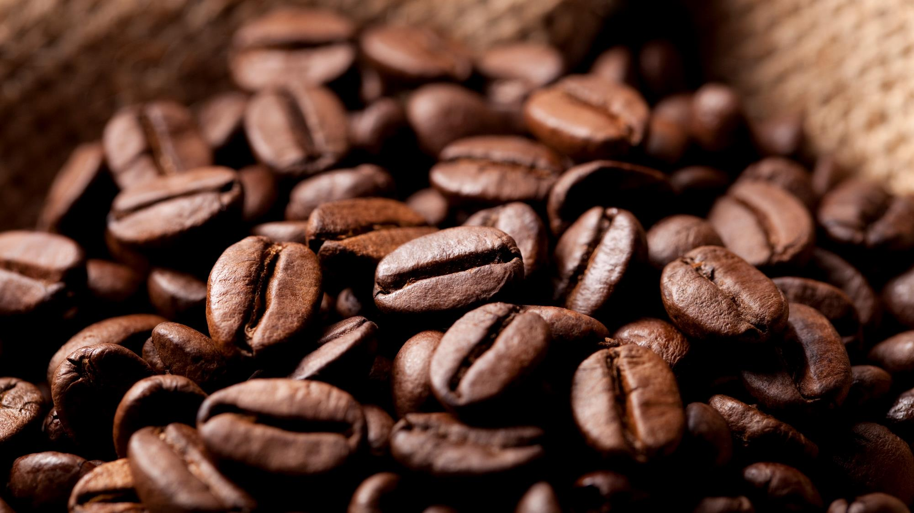
Coffee Cafe Market Basket Analysis
By,
Muthu Pandian G

Slide 2
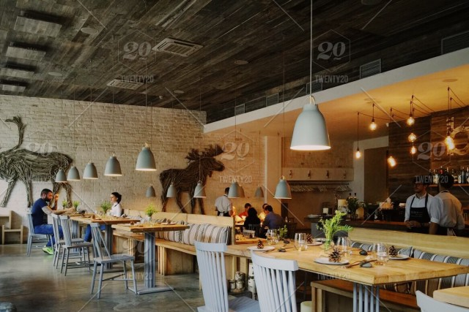
Objective
The Café Chain aims to increase it’s revenue
Restaurant has no loyalty Program
Dataset with customer level information not available only Point of sale data is available.
We need to provide a set of recommendations that can help the Café Chain to increase his revenues.

Slide 3
Exploratory Analysis
The Total Bill Quantity at POS is 1,63,519 with total amount of ₹ 3,280,5895
Top Quantities sold with respective Categories
Food – 62,141
Beverages – 50,637
Tobacco – 37,384
Liquor – 10,283
Misc – 1,385
Wines – 1,074
Foods and Beverages are the most sold items in terms of Quantity.

Slide 4
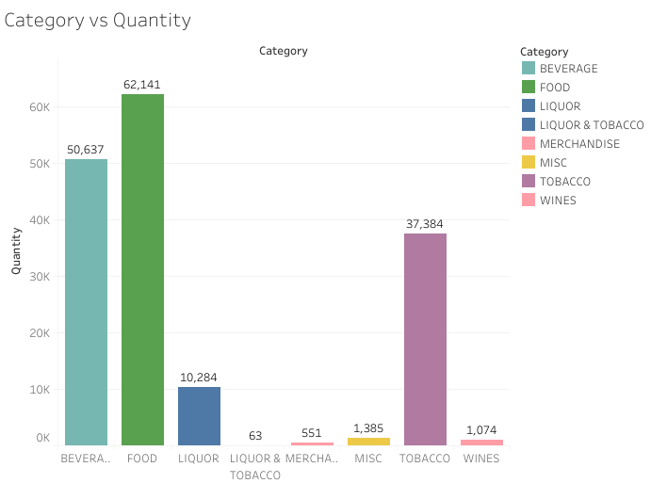
Exploratory Analysis

Slide 5
Exploratory Analysis
Low Sales / Demand Products:
Liquor and Tobacco – 63
Merchandise – 551
Liquor and Tobacco / Merchandise products are the products that are sold in less quantity.

Slide 6
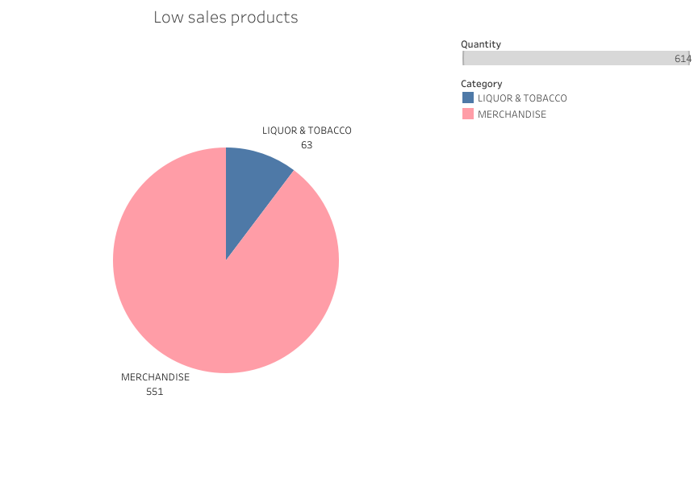
Exploratory Analysis

Slide 7
Exploratory Analysis
High Priced Products:
Liquor and Tobacco
Tobacco
Wines
Merchandise
Since Liquor and Tobacco / Merchandise products are highly priced our customers bought those products in less quantity.

Slide 8
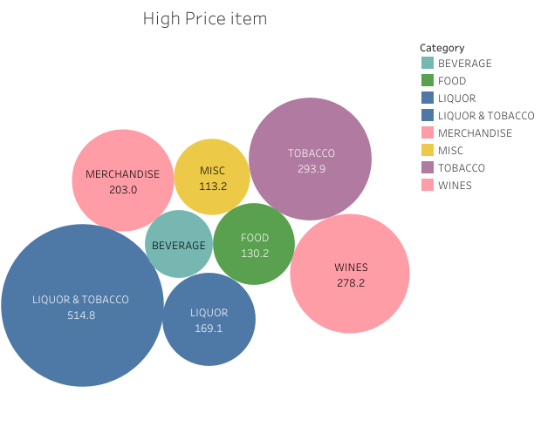
Exploratory Analysis

Slide 9
Exploratory Analysis
High Sold Products in each categories:
Beverages:
Cappuccino and Qua Mineral Water 1000 ML
Food
B.M.T. Panini, GREAT LAKES CREAM, CHL Avalanche, Poutine with Fries
Liquor
CARLSBERG
Tobacco
NIRVANA HOOKAH SINGLE, Mint Flavor, Sambuca, Calcutta Mint

Slide 10
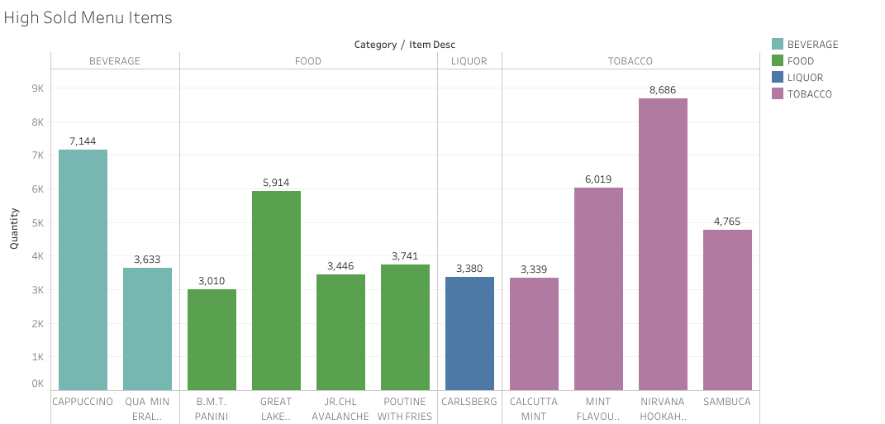
Exploratory Analysis

Slide 11
Exploratory Analysis
Low Sold Products in Top categories:
Beverages:
2 Axe Twist ,Decaffinate Coffee Frappe, Mocafe Hot Chocolate
Food
ADD Buttered Toast, Caponata
Liquor
Zinzi white (BTL)
The above mentioned items are rarely sold and are quite pricey, so they can be removed from the menu as it doesn’t yield us a huge profit.

Slide 12
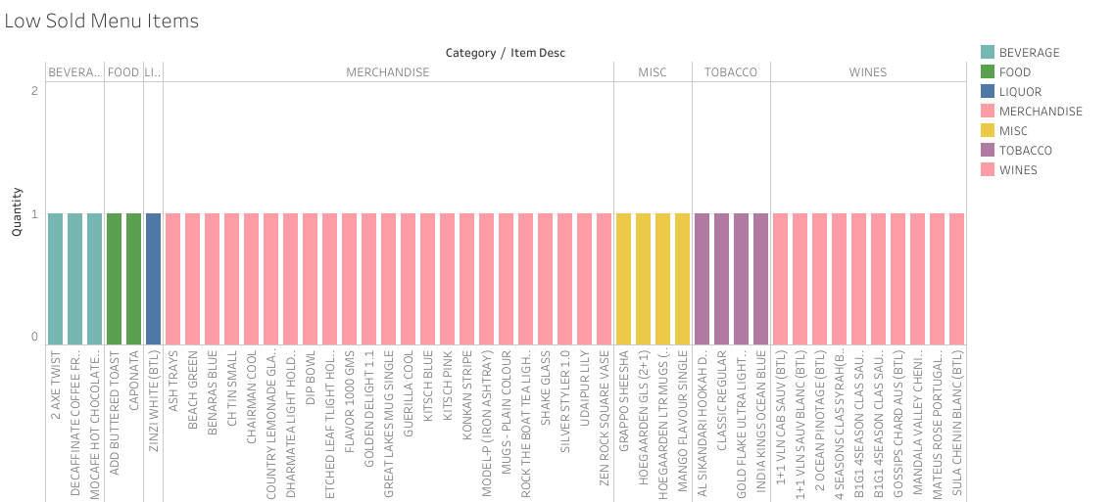
Exploratory Analysis

Slide 13
Exploratory Analysis
Customer Behavior at different Times of the Day :
From the trend chart, we can see that there is increase in the POS after 10 AM, i.e. Our Customer mostly prefer Meals and Dinner as the POS peaks around 1pm and 8pm almost daily
So we need to introduce more meals and Beverages combo’s to increase our revenue.

Slide 14
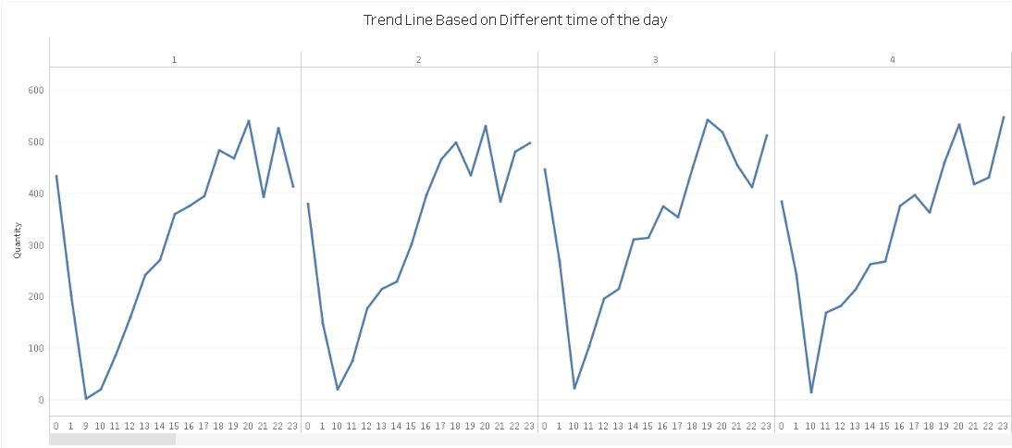
Exploratory Analysis

Slide 15
Exploratory Analysis
Customer Behavior at different times of the week :
From the trend chart, we can see that there is a steady decrease in customers sales during the start of the week and it gradually increases around the weekends which is quite understandable.

Slide 16
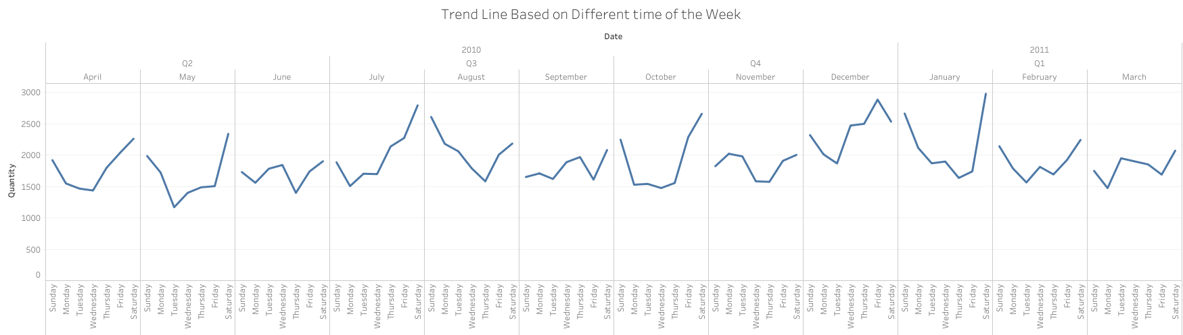
Exploratory Analysis

Slide 17
Exploratory Analysis
Customer Behavior at different times of the month :
On an Average, we have around 13k sales per month, the sales peaks around the month of December which is quite understandable as it has lot of festivals(Christmas / New Year).

Slide 18
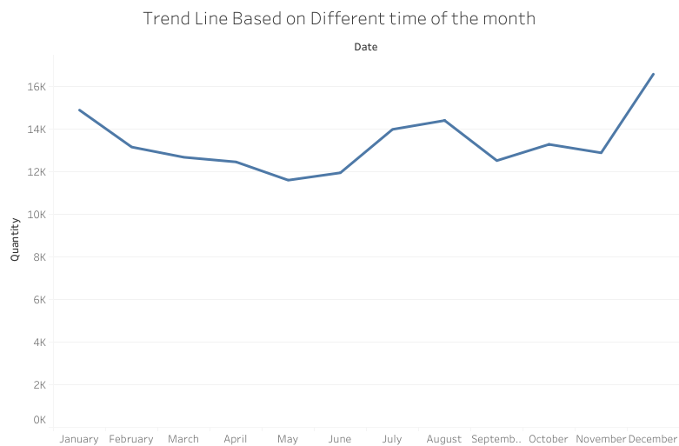
Exploratory Analysis

Slide 19
Market Basket Analysis
Most popular combos our customer bought :
- ADD VANILLA FLAVOUR + CAFFE LATTE
- ADD CARAMEL FLAVOUR + CAFFE LATTE
- BUTTERED TOASTS + KHEEMA GHOTALA
- ADD HERB ROAST CHICKEN + LEMON INFUSED CHAR GRILLED VEG
- ADD HERB ROAST CHICKEN + ORANGE ARRABIATA
- ADD HAZELNUT FLAVOUR + CAFFE LATTE
- ADD HAZELNUT FLAVOUR + CAPPUCCINO
- 3 RED BULL + NIRVANA HOOKAH SINGLE
- VANILLA ICECREAM + GREAT LAKES SHAKE
- FRENCH FRIES + B.M.T. PANINI
- TRADITIONAL ITALIAN CRUSTINI + ADD FRIES
- QUA MINERAL WATER(500ML) + NIRVANA HOOKAH SINGLE
- ADD FRIES + B.M.T. PANINI
- RED BULL 2+1 + SAMBUCA

Slide 20
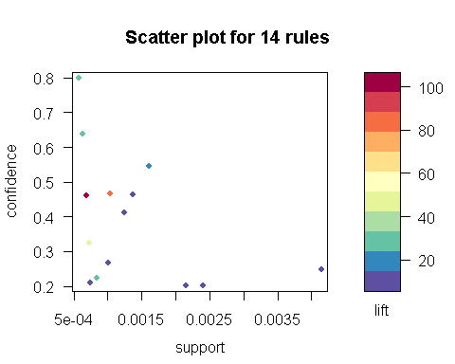
Market Basket Analysis

Slide 21
Market Basket Analysis
Suggested Combos based on MBA:
Based on Market Basket Analysis, I would suggest the below combos for meals,
- ADD HERB ROAST CHICKEN + LEMON INFUSED CHAR GRILLED VEG
- FRENCH FRIES + B.M.T. PANINI
- TRADITIONAL ITALIAN CRUSTINI + ADD FRIES

Slide 22
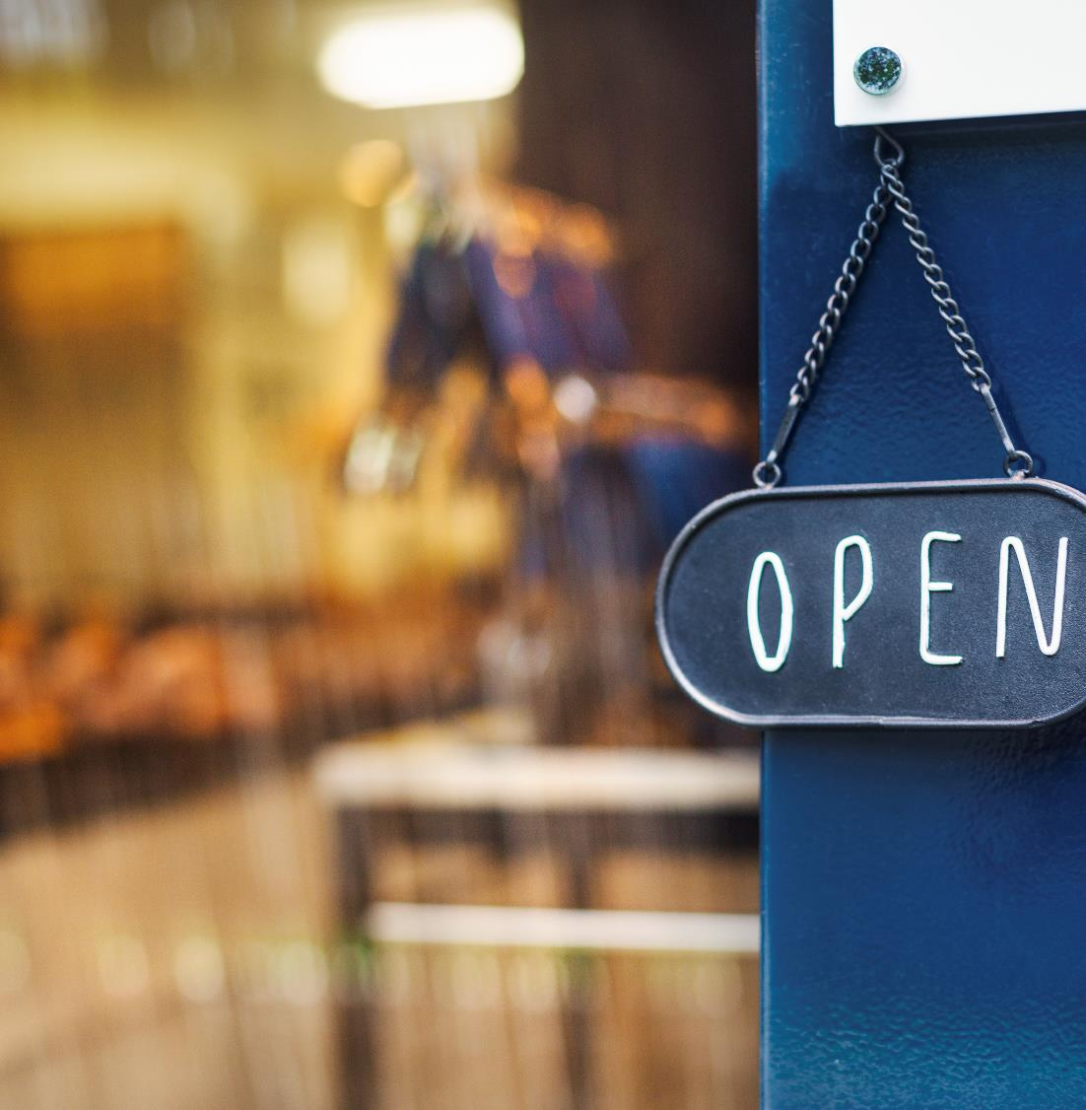
Thank You

